Slide 1
Shiny And Flex Dashboards
Class 5

Slide 2
Agenda
Shiny Dashboard
Flexdashboard
Publishing to shinyapps.io
Next week

Slide 3
Shiny Dashboard

Slide 4
Basic Layout
Dashboards are broken into a single argument made up of three arguments
Header – Window title as well as Menus
Sidebar – Sidebar for navigating Dashboard tabs and can hold global selection inputs
Body – Where the magic happens.

Slide 5
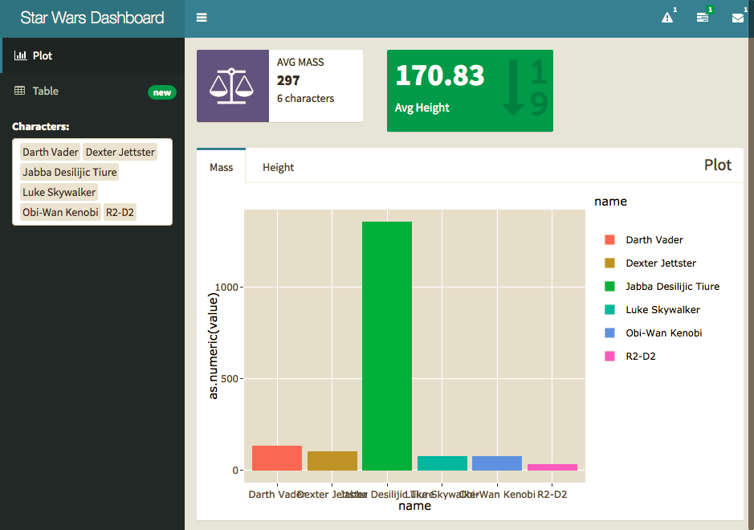

Slide 6
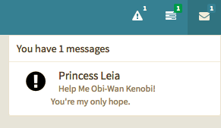
Headers

Slide 7
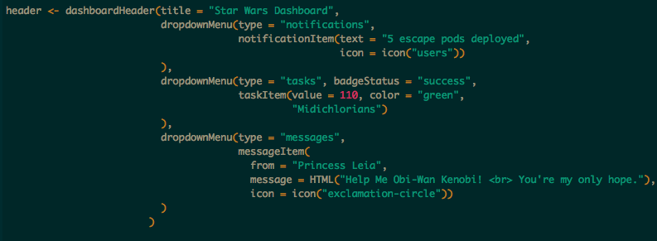

Options
Notifications
Tasks
Messages

Slide 8
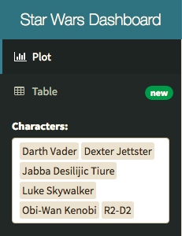
Sidebar

Slide 9
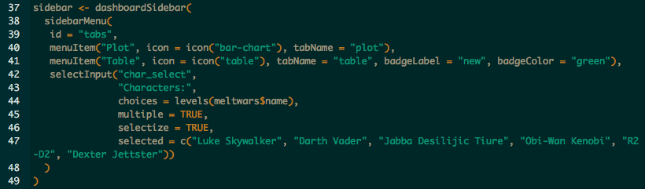
Menu Items – tabName referenced in body.
Global Inputs – Should work on all tabs and for all visuals.

Slide 10
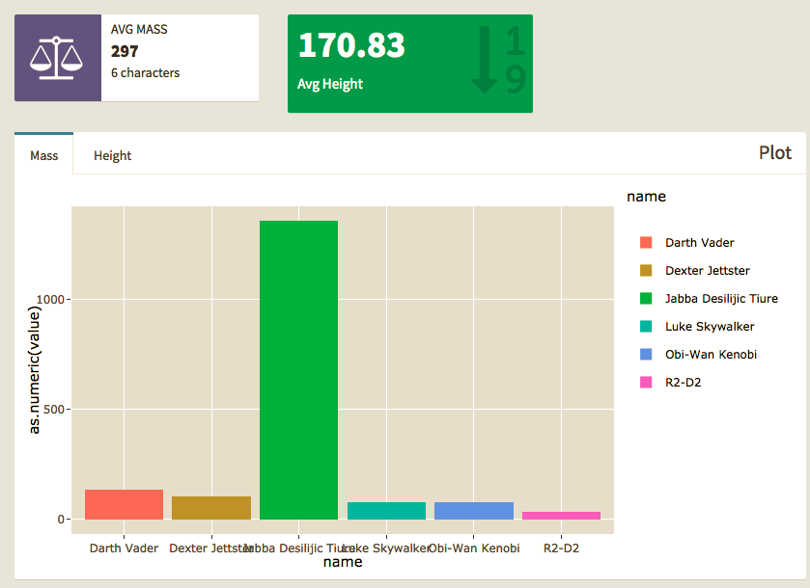
Body

Slide 11
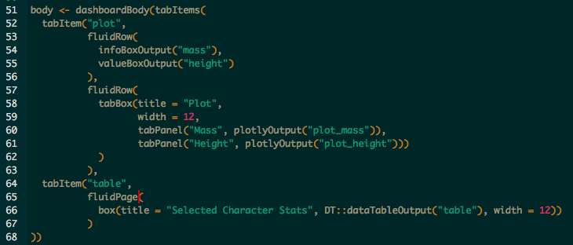
Tab Items – by name in Menu
Row\Page – based layouts
Box – All contents should go in a box
Page is broken into 12 equal bars. Width can be 1-12
If 12+ is specified content will kick to new row automatically, anything unspecified will get squished.
Inputs – can also go in boxes here should be clear what visuals they work with.

Slide 12
Practice
Storyboard - Blank

Slide 13
Flexdashboard

Slide 14
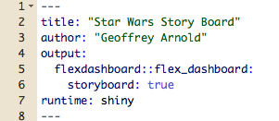
Setup

Slide 15
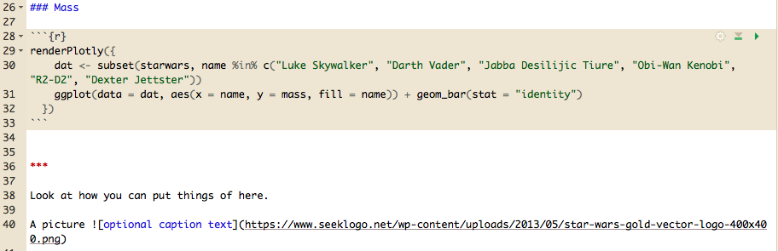
Basic Board Page

Slide 16
Shiny Apps.io
http://www.shinyapps.io/
Section 6

Slide 17
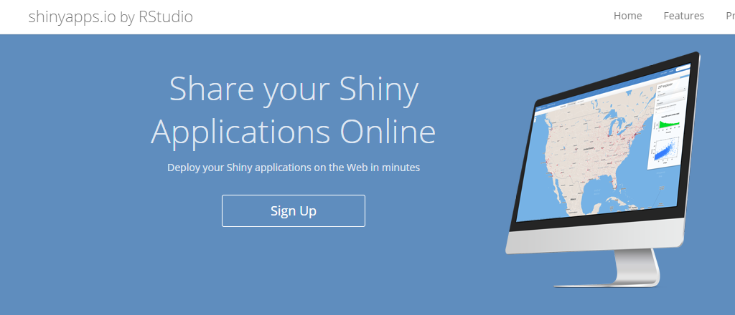
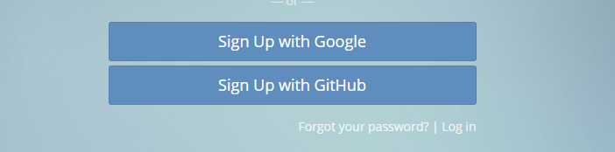
Register a free Account

Slide 18
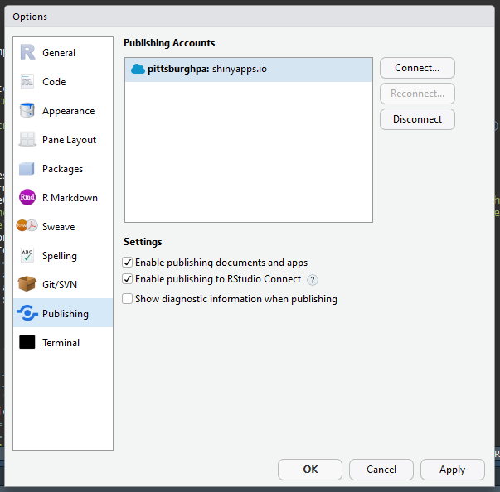
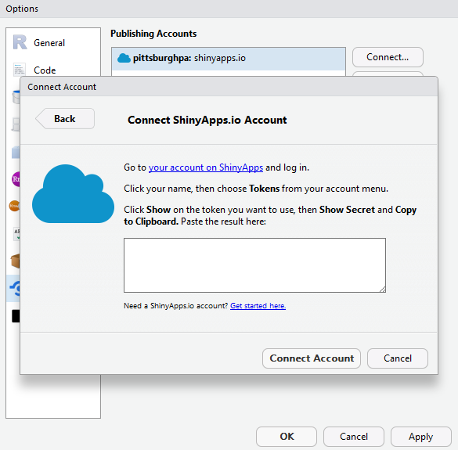
Connect your account

Slide 19

Publish one of todays apps!

Slide 20
For Next class

Slide 21
Please be able to load the following libraries
httr
Make API calls
jsonlite
Easily load and read JSON objects in R

